Slide 1
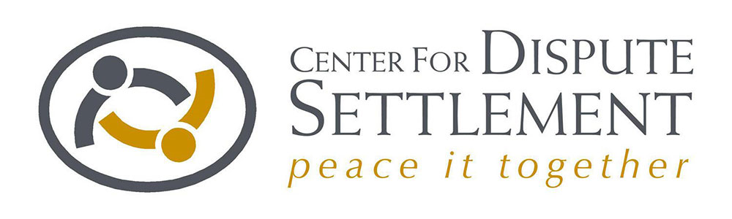

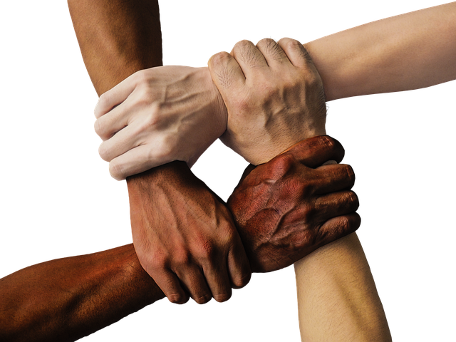
Creating Peaceful Communities

Slide 2
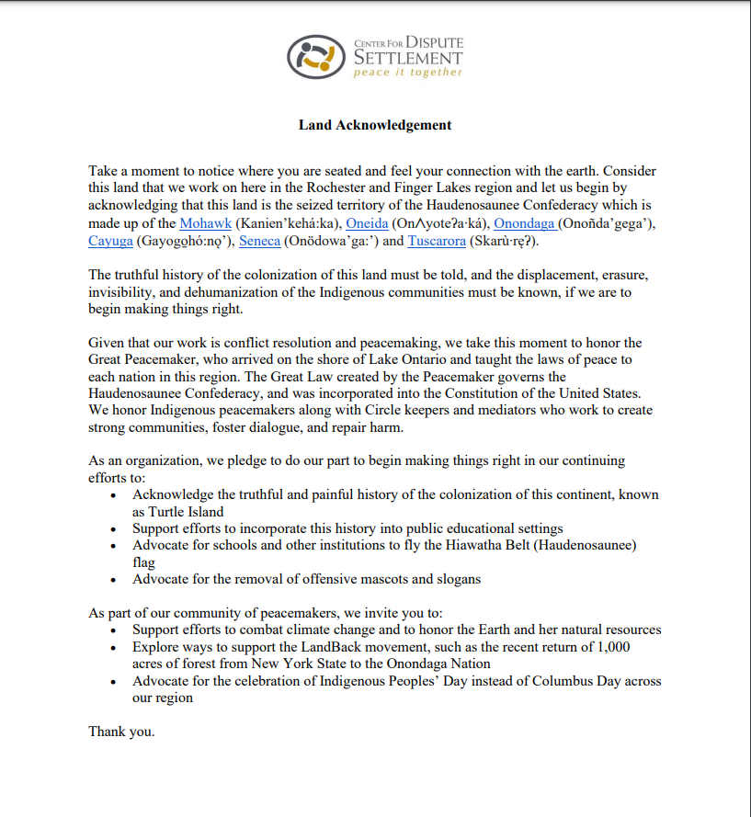
Land Acknowledgment

Slide 3
About CDS
Mission:
  To use and promote peaceful dispute resolution processes throughout our communities
Established in 1973 during the Civil Rights movement
1st Community Dispute Resolution Center in NYS and 3rd in the country
Serving the Unified Court System 7th Judicial District

Slide 4
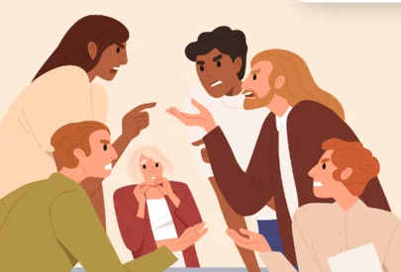
What is Conflict?
A crisis in human interaction.
An inevitable part of being human.
Can be handled in positive or negative ways.
Neither good nor bad. It is what you do with it that matters.

Slide 5

What Helps To Transform Conflict?
Empowerment: Having choice and access to resources to meet needs.
Recognition: Having awareness and curiosity toward others.

Slide 6
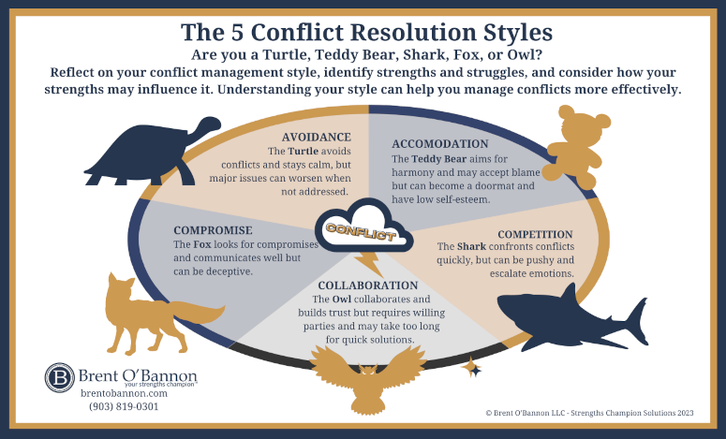
Conflict Styles

Slide 7
Conflict Resolution Services
Mediation
Restorative Practices
Conflict Coaching
Community Dialogue Facilitation
Conflict Skills Training

Slide 8
Mediation
Voluntary, neutral, confidential, safe
Intake process:
  explaining the process, data collection, needs assessment, determine participants
Consent is required; even if it’s mandated by court or other institution
Typically 2 hours, in-person or Zoom options
Written agreement upon requested
Post-mediation survey

Slide 9
What do you think are the benefits of mediation?

Slide 10
Benefits
Peace
Clarity
Respect
Honesty

Slide 11
Restorative Practices
Based on Indigenous practices, e.g., Circles
Used to strengthen relationships, build a sense of community, and collaboratively respond to harm
Used for both proactive and responsive purposes
Used to increase access, inclusion, and equity
Includes both informal and formal processes
Can result in a written agreement, if requested

Slide 12
What do you think are the benefits of restorative practices?

Slide 13
Benefits
Forgiveness
Peace
Education/Knowledge

Slide 14
Conflict Coaching
Short-term individual service, up to 6 sessions
Telling the story of the conflict
Identify feelings, needs, issues of power and identity
Skill building and practice
Making a plan to address the conflict

Slide 15
What do you think are the benefits of conflict coaching?

Slide 16
Benefits
Preparation for mediation
Being calm in tense situations
Facilitating peaceful conversations

Slide 17
Community Dialogue Facilitation
Can be used to address large scale issues on campus
Involves multiple interventions over a period of time
Involves gaining entry and access to multiple communities or groups
Brings together representatives from each group to address the issue
Can result in an accountability plan

Slide 18
Training Topics
Mediator training and certification
Conflict skills
Anger management
Implicit bias and microaggressions
Diversity, equity, inclusion, and belonging
Restorative practices
De-escalation skills
The power of dialogue

Slide 19
Making a Referral
Call our office: 585-546-5110
Email us: info@cdsadr.org
Fill out our online form: www.cdsadr.org
Find us on social media
  Facebook
  LinkedIn

Slide 20
Contact Information
Jose Cruzado, Director of Operations : jcruzado@cdsadr.org
CaTyra Polland, Training & Community Engagement Coordinator: cpolland@cdsadr.org
Sign up for our newsletter to receive event updates:
https://www.cdsadr.org/?q=newsletter-signup

